Slide 1
TUBERCULOSIS
Student’s Name

Slide 2
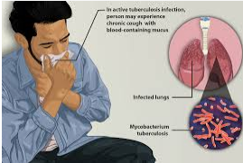
overview
Tuberculosis is one of the most prevalent infection in human being contributing widely to death and illness across the world.
The disease is spread by inhaling tiny droplets of saliva from the sneezes and coughs from the infected people.
It is also slowly spreading, chronic, granulomatous
and it is characterized by a gradual loss in weight.
Tb is the world’s second common cause of
death after HIV/AIDS.
Notes:
Tuberculosis is an infectious disease that is mainly affecting the lungs parenchyma and is more often caused by Mycobacterium Tuberculosis.
It may also spread to any part of the body including meninges, bones and lymph-nodes and kidney.
With an increased incidence of Aids, TB has become one of the greatest problem in the U.S and the whole world.

Slide 3
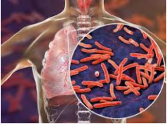
What is Tuberculosis
Tuberculosis, or TB, is a bacterial infection that usually infects the lungs. Other organs, such as the kidneys, spine, or brain may also be involved.
TB is primarily spread from person to person in an airborne manner, such as when an infected person coughs or sneezes.
It can also cause an active infection after a
period of not being active in someone
who was exposed at an earlier time.
There is a difference between being infected
with the TB bacterium and having active tuberculosis.

Slide 4
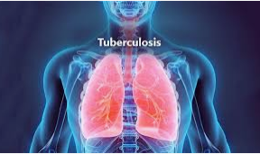
Stages of TB
Exposure. This happens when a person has been in contact with, or exposed to, another person who has TB. The exposed person will have a negative skin test, a normal chest X-ray, and no signs or symptoms of the disease.
Latent TB infection. This happens when a person has TB bacteria in his or her body, but does not have symptoms of the disease.
The infected person's immune system walls off the
TB organisms, and the TB remains inactive throughout
life in most people who are infected. This person would have
a positive skin test, but a normal chest X-ray.
TB disease. This describes the person who has signs and symptoms
of an active infection. The person would have a positive skin test and
a positive chest X-ray.

Slide 5

What causes TB?
The main TB bacterium is Mycobacterium tuberculosis (M. tuberculosis).
Many people infected with this bacterium never develop active TB. They remain in the latent (inactive) TB stage.
However, in people with weak immune systems,
especially those with HIV, or those receiving medicines
that suppress the immune system, TB organisms
can overcome the body's defenses, multiply, and cause
an active disease (Sterling et.al.2020).
The TB bacterium is spread through the air when an infected
person coughs, sneezes, speaks, sings, or laughs.
Notes:
It’s not likely to be spread through personal items, such as clothing, bedding, a drinking glass, eating utensils, a handshake, a toilet, or other items that a person with TB has touched.
Good ventilation is the most important measure to prevent the transmission of TB.

Slide 6

Who is at risk for TB?
TB affects all ages, races, income levels, and both genders. Those at higher risk include the following:
People who live or work with others who have TB
Those who can’t access health care
Homeless people
People from other countries where TB is prevalent
People in group settings, such as nursing homes
People who abuse alcohol
People who use intravenous drugs
People with weak immune systems
The elderly
Healthcare workers who come in contact with high-risk populations
Notes:
TB affects all ages, races, income levels, and both genders

Slide 7

What are the symptoms of TB?
The following are the most common symptoms of active TB. However, each person may experience symptoms differently:
Cough that lasts 3 weeks or longer
Chest pain
Fatigue
Loss of appetite
Unintended weight loss
Poor growth in children
Fever
Coughing blood or sputum
Chills or night sweats
Notes:
The symptoms of TB may look like other lung conditions or medical problems.
Talk with a healthcare provider for a diagnosis.

Slide 8
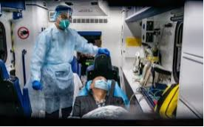
How is TB diagnosed?
TB is often diagnosed with a skin test. In this test, a small amount of testing material is injected into the top layer of the skin.
If a certain size bump develops within 2 or 3 days,
the test may be positive for tuberculosis infection.
Other tests include X-rays and sputum tests.
A blood test can be done in place of the TB skin test.
TB skin tests are suggested for those:
In high-risk categories
Who live in close contact with people who are at high risk
Who have never had a TB skin test

Slide 9
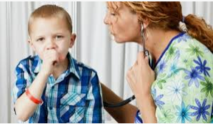
Skin testing in children
For skin testing in children, the American Academy of Pediatrics recommends testing:
If the child is thought to have been exposed in the last 5 years
If the child has an X-ray that looks like TB
If the child has any symptoms of TB
If the child comes from a country where TB is prevalent
For children with HIV
For children receiving medicines that suppress the immune system
For children who are in detention facilities
For children who are exposed to high-risk people
If the child's parent has come from a high-risk country
If the child has traveled to high-risk areas
If the child lives in a densely populated area

Slide 10

Type of tests
TB is usually examined using three types of tests;
Blood tests
Imaging tests
Sputum tests

Slide 11
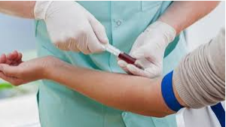
Blood tests
Blood tests may be used to confirm or rule out latent or active tuberculosis.
These tests use sophisticated technology to
measure your immune system's reaction to TB.
These tests require only one office visit.
A blood test may be useful if you're at
high risk of TB infection but have a negative
response to the skin test.

Slide 12
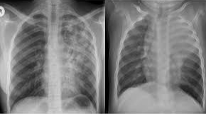
Imaging tests
If you've had a positive skin test, your doctor is likely to order a chest X-ray or a CT scan.
This may show white spots in your lungs
where your immune system has
walled off TB bacteria, or it may reveal
changes in your lungs caused by
active tuberculosis (Sudre et.al. 2012).
CT scans provide more-detailed images
than do X-rays.

Slide 13

Sputum tests
If the chest X-ray shows signs of tuberculosis, the doctor may take samples of sputum — the mucus that comes up when you cough. The samples are tested for TB bacteria.
Sputum samples can also be used to test
for drug-resistant strains of TB.
This helps the doctor to choose the medications
that are most likely to work. These tests can take four
to eight weeks to be completed.

Slide 14
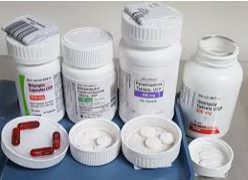
How is TB treated?
The healthcare provider figure out the best treatment for individuals based on:
How old they are
Your overall health and past health
How sick they are
How well you can handle specific medicines,
procedures, or therapies
How long the condition is expected to last
Their opinion or preference

Slide 15
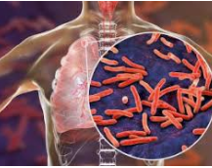
Treatment option
Short-term hospitalization
For latent TB which is newly diagnosed: Usually a 6 to 12 month course of antibiotic called isoniazid will be given to kill off the TB organisms in the body. Some people with latent TB may be treated with a shorter course of 2 antibiotics for only 3 months.
For active TB: Your healthcare provider may
prescribe 3 or more antibiotics in combination
for 6 to 9 months or longer (Reid et.al.2019).
Examples include: isoniazid, pyrazinamide, and ethambutol.
People usually begin to improve within a few weeks.
Notes:
After several weeks of treatment with the correct medicines, the person is usually no longer contagious, if treatment is carried through to the end, as prescribed by a healthcare provider

Slide 16
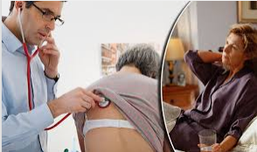
TB treatment and management
Isolate patients with possible tuberculosis (TB) infection in a private room with negative pressure
air should be exhausted to outside or through a high-efficiency particulate air filter).
Medical staff must wear high-efficiency
disposable masks sufficient to filter the
tubercle bacillus. Continue isolation until
sputum smears are negative for 3 consecutive
determinations

Slide 17

Medication side effects
Serious side effects of TB drugs aren't common but can be dangerous when they do occur. All tuberculosis medications can be highly toxic to your liver. When taking these medications, call your doctor immediately if you experience any of the following:
Nausea or vomiting
Loss of appetite
A yellow color to your skin (jaundice)
Dark urine
A fever that lasts three or more days and
has no obvious cause

Slide 18

Completing treatment is essential
After a few weeks, patients will be contagious and they may start to feel better. It might be tempting to stop taking TB drugs.
But it is crucial that patient finish the full course of therapy and take the medications exactly as prescribed by your doctor.
Stopping treatment too soon or skipping doses
can allow the bacteria that are still alive to
become resistant to those drugs, leading to
TB that is much more dangerous and difficult to treat.

Slide 19
References
Sudre, P., Ten Dam, G., & Kochi, A. (2012). Tuberculosis: a global overview of the situation today. Bulletin of the World Health Organization, 70(2), 149.
Reid, M. J., Arinaminpathy, N., Bloom, A., Bloom, B. R., Boehme, C., Chaisson, R., ... & Goosby, E. P. (2019). Building a tuberculosis-free world: The Lancet Commission on tuberculosis. The Lancet, 393(10178), 1331-1384.
Sterling, T. R., Njie, G., Zenner, D., Cohn, D. L., Reves, R., Ahmed, A., ... & Belknap, R. (2020). Guidelines for the treatment of latent tuberculosis infection: recommendations from the National Tuberculosis Controllers Association and CDC, 2020.

